Slide 1
Finding Probabilistic Nearest Neighbors for Query Objects with Imprecise Locations
Yuichi Iijima and Yoshiharu Ishikawa
Nagoya University, Japan

Slide 2
Outline
Background and Problem Formulation
Related Work
Query Processing Strategies
Experimental Results
Conclusions

Slide 3
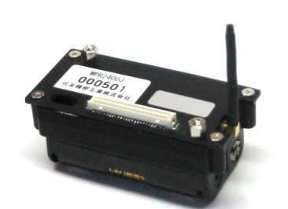
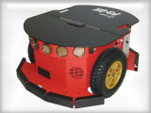
Imprecise Location Information
Sensor Environments
  Measurement Noise
  Frequent updates may not be possible
    GPS-based positioning consumes batteries
Robotics
  Localization using sensing and
  movement histories
  Probabilistic approach has
  vagueness
Privacy
  Location Anonymity

Slide 4
Nearest Neighbor Queries
Nearest Neighbor Queries
  Example: Find the closest bus stop
  Traditional problem in spatial databases
    Efficient query processing using spatial indices
    Extensible to multi-dimensional cases (e.g., image retrieval)
What happen if the
location of query object
is uncertain?
NN of q
q

Slide 5
Example Scenario (1)
Query: Find the nearest gas station
Location estimation based on noisy GPS data

Slide 6
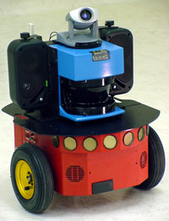
Example Scenario (2)
Mobile Robotics
  Location of the robot is estimated
  based on movement histories and
  sensor data
  Measurements are noisy
  Localization based on probabilistic
  modeling
    Kalman filter, particle filter, etc.
  Estimated location is given as a
  probabilistic density function (PDF)
    PDF changes on each estimation

Slide 7
Probabilistic Nearest Neighbor Query (1)
p_{q}(x)
PNNQ for short
Assumptions
  Location of query object
  q is specified as a
  Gaussian distribution
  Target data: static points
Gaussian Distribution
  Σ: Covariance matrix

Slide 8
Probabilistic Nearest Neighbor Query (2)
Definition
Find objects which
satisfy the condition
  The probability that
  the object is the
  nearest neighbor of q
  is greater than or
  equal to θ
q

Slide 9
Outline
Background and Problem Formulation
Related Work
Query Processing Strategies
Experimental Results
Conclusions

Slide 10
Related Work
Query processing methods for uncertain (location) data
  Cheng, Prabhakar, et al. (SIGMOD’03, VLDB’04, …)
  Tao et al. (VLDB’05, TODS’07)
  Consider arbitrary PDFs or uniform PDFs
  Most of the case, target objects are imprecise
Research related to Gaussian distribution
  Gauss-tree [Böhm et al., ICDE’06]
    Target objects are based on Gaussian distributions
Our former work
  Ishikawa, Iijima, Yu (ICDE’09): Probabilistic range queries

Slide 11
Outline
Background and Problem Formulation
Related Work
Query Processing Strategies
Experimental Results
Conclusions

Slide 12
Naïve Approach (1)
Use of Voronoi Diagram
  Well-known method for standard (non-imprecise) nearest neighbor queries
Voronoi region V_{e}

Slide 13
Naïve Approach (2)
Pr_{NN}(q, o): Nearest neighbor probability
  Probability that object o is the nearest
  neighbor of query object q
  It can be computed by integrating the
  probability density function p_{q}(x) over
  Voronoi region V_{o}
Problem
  Need to consider all target
  objects
  Numerical integration (Monte
  Carlo method) is quite costly!
p_{q}(x)
p_{q}(x)
V_{e}

Slide 14
Our Approach
Outline of processing
  Filtering
    Prune non-candidate objects whose Pr_{NN} are obviously smaller than the threshold θ
    Low-cost filtering conditions
  Numerical integration for the remaining candidate objects
Two strategies
  θ-region-based Approach
  SES-based Approach
    SES: Smallest Enclosing Sphere

Slide 15
Strategy 1: θ-Region-Based Approach (1)
θ-region
  Similar concepts are often used in query processing for uncertain spatial databases
  Definition: Ellipsoidal region for which the result of the integration becomes 1 – 2θ :
  The ellipsoidal region
  is the θ-region
Example: θ is specified as 1%,
we consider 98% θ -region
q
θ -region

Slide 16
Strategy 1: θ-Region-Based Approach (2)
Query Processing
  θ-region for the query is computed at first
    θ-region can be derived using r_{θ}-table:
      It is constructed for the normal Gaussian (Σ = I, q = 0): Given θ, it returns appropriate r_{θ}
    Final θ-region can be obtained by transformation
  Derive the bounding box of
  θ-region
  Objects whose Voronoi
  regions overlaps with the
  box are the candidates
    {a, c, d, f, g}, in this example
a
c
d
f
g
θ-region

Slide 17
Strategy 1: θ-Region-Based Approach (3)
Derivation details
First, we consider the normal Gaussian
  Using r_{θ}-table, we can get the appropriate r_{θ} for given θ
Second, a spherical θ-region is derived based on transformation
  Transformation is performed by analyzing Σ
Third, the bonding box is calculated
where (Σ)_{ii} is the (i, i) entry of Σ
x_{j}
w_{j}
r_{θ}
x_{i}
q
q
q
w_{j}
w_{i}
w_{i}

Slide 18
Strategy 2: SES-Based Approach (1)
SES: Smallest Enclosing Sphere
  For each Voronoi region V_{o}, we compute its SES SES_{o} beforehand
SES_{e}: SES for Voronoi region of e

Slide 19
Strategy 2: SES-Based Approach (2)
Integration over SES_{o} gives the upper-bound for Pr_{NN}(q, o)
  Integration over a sphere region is more easier to compute
    We use a table called
    U-catalog constructed
    beforehand
p_{q}(x)

Slide 20
Strategy 2: SES-Based Approach (3)
What is U-catalog?
  Given two parameters α and δ, it returns corresponding integral
  U-catalog is made for different (α, δ ) pairs by computing the integral of normal Gaussian over sphere region R
α | δ | π(α, δ)
0.0 | 0.1 | …
0.0 | 0.2 | …
… | … | …
1.0 | 0.1
… | … | …

Slide 21
Strategy 2: SES-Based Approach (4)
To use U-catalog, another approximation is required since it is only useful for normal Gaussian
  Use of upper-bounding function p_{q}(x)
  p_{q}(x) tightly bounds p_{q}(x) and has spherical isosurfaces
  For p_{q}(x), we can easily derive its integral over SES_{o} using
  U-catalog
In summary, we use two
approximations:
T
T
T
T
p_{q}(x)
p_{q}(x)

Slide 22
Strategy 2: SES-Based Approach (5)
Bounding Function
  Original Gaussian PDF
  Upper-Bounding Function
  where
is satisfied

Slide 23
Outline
Background and Problem Formulation
Related Work
Query Processing Strategies
Experimental Results
and Conclusions

Slide 24
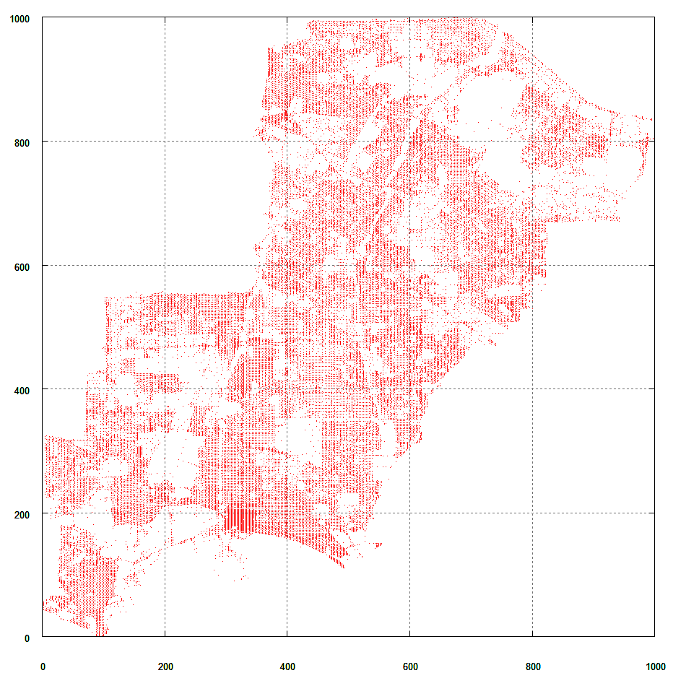
Setup of Experiments (1)
Target Data
  2D point data (50K entries)
  Based on road line
  segments in Long Beach
Computation of Voronoi
regions and SESs
  LEDA package was used
Comparison
  Strategies 1, 2, and their hybrid approach
  Evaluation metric: Response time

Slide 25
Setup of Experiments (2)
Default Parameters
  Covariance matrix
    For this matrix the shape of the isosurface of p_{q}(x) is an ellipse titled at 30 degrees and the major-to-minor axis ratio is 3:1
    γ : Parameter for controlling vagueness (default: γ = 10)
  Probability threshold value: θ = 0.01
  No. of samples for Monte Carlo method: 1,000,000
p_{q}(x)

Slide 26
Candidate Objects in Strategy 1
Bounding box of the θ-region
Query center
Voronoi regions for candidate objects
Voronoi regions for answer objects

Slide 27
Candidate Objects in Strategy 2
Query center
Voronoi regions for candidate objects
Voronoi regions for answer objects

Slide 28
Candidate Objects in Hybrid Strategy
Bounding box of the θ-region
Query Center
Voronoi regions for candidate objects
Voronoi regions for answer objects

Slide 29
Experimental Results - Default Parameters
Most of the processing time is spent in numerical integration
  A strategy that can prune more objects has better performance
Number of candidates | 179 | 150 | 129
Number of answers | 26

Slide 30
Experimental Results - Different γ Values
γ = 1
(almost exact)
γ = 10
γ = 50
(too vague)
Number of candidates | 24 | 31 | 23
Number of answers | 8
179 | 150 | 129
26
847 | 276 | 260
15
Query is costly when impreciseness is high

Slide 31
Experimental Results - Different θ Values
θ = 0.01
θ = 0.03
θ = 0.05
Number of candidates | 179 | 150 | 129
Number of answers | 26
128 | 76 | 68
7
107 | 44 | 40
3

Slide 32
Experimental Results - Different Shapes
Circle
Default Ellipse
Narrow Ellipse
Number of candidates | 115 | 50 | 49
Number of answers | 26
179 | 150 | 129
26
276 | 366 | 250
24
Narrow ellipse (correlated distribution) needs to consider additional candidates

Slide 33
Conclusions of Experimental Results
Most of the processing time is spent in numerical integration
  A strategy that can prune more objects has better performance
Superiority or inferiority of two strategies depends on the given query and the specified parameters
  No apparent winner
The hybrid strategy inherits the benefits of two strategies and shows the best performance

Slide 34
Outline
Background and Problem Formulation
Related Work
Query Processing Strategies
Experimental Results
Conclusions

Slide 35
Conclusions
Nearest neighbor query processing methods for imprecise query objects
  Location of query object is represented by Gaussian distribution
  Two strategies and their combination
  Reduction of numerical integration is important
  Proposal of two pruning strategies and their evaluation
Future work
  Evaluation for multi-dimensional cases (d ≥ 3)

Slide 36
Finding Probabilistic Nearest Neighbors for Query Objects with Imprecise Locations
Yuichi Iijima and Yoshiharu Ishikawa
Nagoya University, Japan

